Slide 1
Session 20 Inheritance
Dr. Naveen Kumar
Associate Professor
Amity Institute of Information Technology
Amity University Patna

Slide 2
Data Hinding
Data members (Internal data) should not be accesses outside directly that is outside person can't access our internal data directly.
By using private modifier we can implement data hiding.
Example:
class Account {
private double balance;
......................;
......................;
}
After providing proper username and password only , we can access our Account information.
The main advantage of data hiding is security.
Note: recommended modifier for data members is private.

Slide 3
Abstraction
Hide internal members and just highlight the set of necessary services, is called abstraction.
By using abstract classes and interfaces we can implement abstraction. Example :
By using ATM GUI screen bank people are highlighting the set of services what they are offering without highlighting internal implementation.
The main advantages of Abstraction are:
We can achieve security as we are not highlighting our internal implementation.(i.e., outside person doesn't aware our internal implementation.)
Enhancement will become very easy because without effecting end user we can be able to perform any type of changes in our internal system.
It provides more flexibility to the end user to use system very easily.
It improves maintainability of the application.
It improves modularity of the application.
It improves easyness to use our system.

Slide 4
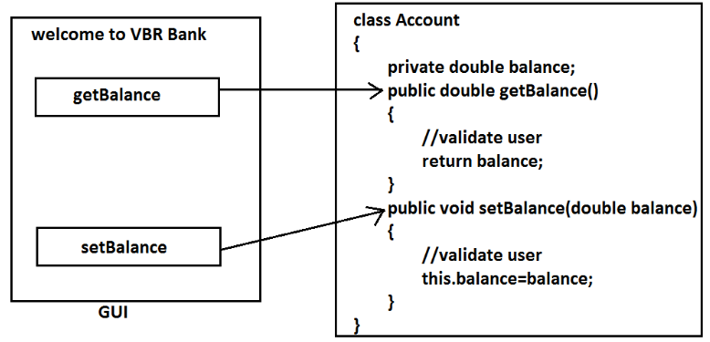
Encapsulation
Binding of data and corresponding methods into a single unit is called Encapsulation .
If any java class follows data hiding and abstraction such type of class is said to be encapsulated class.
Encapsulation=Datahiding+Abstraction

Slide 5
Every data member should be declared as private and for every member we have to maintain getter & Setter methods.
The main advantages of encapsulation are :
We can achieve security.
Enhancement will become very easy.
It improves maintainability and modularity of the application.
It provides flexibility to the user to use system very easily.
The main disadvantage of encapsulation is it increases length of the code and slows down execution.

Slide 6
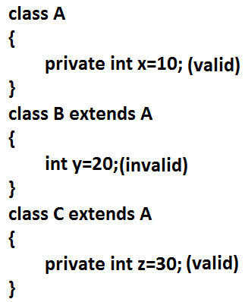
Tightly Encapsulated Class
A class is said to be tightly encapsulated if and only if every variable of that class declared as private whether the variable has getter and setter methods are not , and whether these methods declared as public or not, these checking are not required to perform.
Example:
class Account {
private double balance;
public double getBalance() {
return balance;
}
}
Which of the following classes are tightly
encapsulated?

Slide 7
Which of the following classes are tightly encapsulated?
class A { int x=10; //not
}
class B extends A {
private int y=20; //not
}
class C extends B {
private int z=30; //not
}
Note: if the parent class is not tightly encapsulated then no child class is tightly encapsulated.

Slide 8
Inheritance
IS-ARelationship(inheritance): 1) Also known as inheritance. 2) By using extends keywords we can implement IS-A relationship. 3) The main advantage of IS-A relationship is reusability.
class Parent { public void methodOne()
{ }
}
class Child
{
Public void methodTwo()
{ }
}

Slide 9
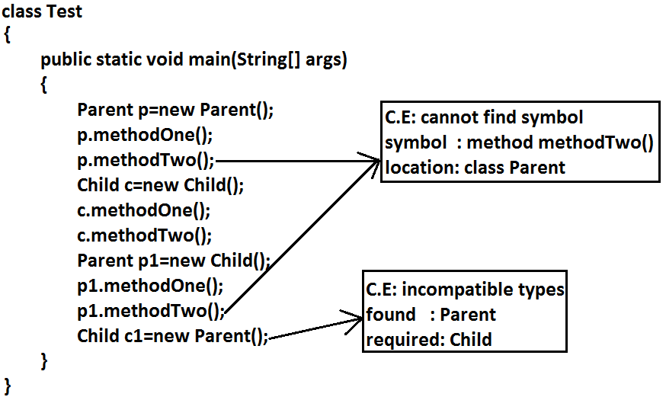

Slide 10
Interpretation
1) Whatever members the parent has by default available to the child but whatever members the child has by default not available to the parent.
Hence on the child reference we can call both parent and child class methods.
But on the parent reference we can call only methods available in the parent class and we can’t call child specific methods. 2) Parent class reference can be used to hold child class object but by using that reference we can call only methods available in parent class and child specific methods we can’t call. 3) Child class reference cannot be used to hold parent class object.

Slide 11
The common methods which are required for housing loan, vehicle loan, personal loan and education loan we can define into a separate class in parent class loan.
So that automatically these methods are available to every child loan class.
This is due to Reusability

Slide 12
class Loan { //common methods which are required for any type of loan. } class HousingLoan extends Loan
{ //Housing loan specific methods. } class EducationLoan extends Loan { //Education Loan specific methods. }

Slide 13
For all java classes the most commonly required functionality is define inside Object class hence Object class acts as a root for all java classes.
For all java exceptions and errors the most common required functionality defines inside Throwable class hence Throwable class acts as a root for exception hierarchy.

Slide 14
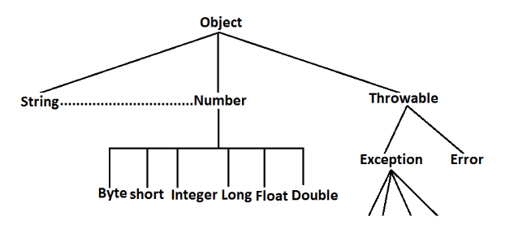

Slide 15
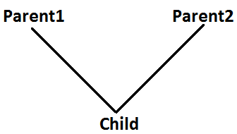
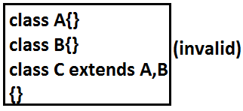
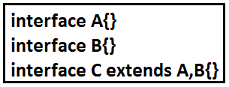
Multiple Inheritance
Having more than one Parent class at the same level is called multiple inheritance.
Any class can extends only one class at a time and can't extends more than one class simultaneously hence java won't provide support for multiple inheritance.
But an interface can extends any no. Of interfaces at a time hence java provides support for multiple inheritance through interfaces.

Slide 16
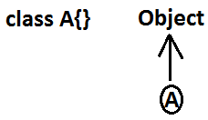
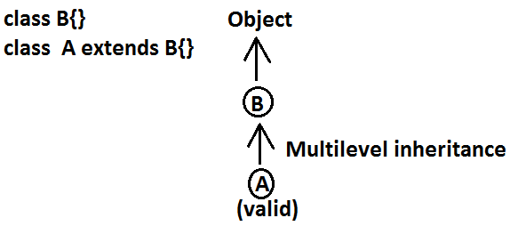
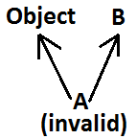
If our class doesn't extends any other class then only our class is the direct child class of object.
If our class extends any other class then our class is not direct child class of object, It is indirect child class of object , which forms multilevel inheritance.
Why java won't provide support for multiple inheritance? There may be a chance of raising ambiguity problems.

Slide 17
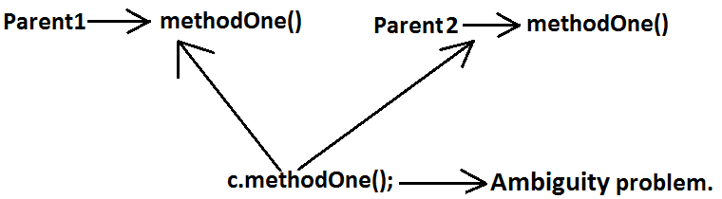
Why ambiguity problem won't be there in interfaces?
Interfaces having dummy declarations and they won't have implementations hence no ambiguity problem.

Slide 18
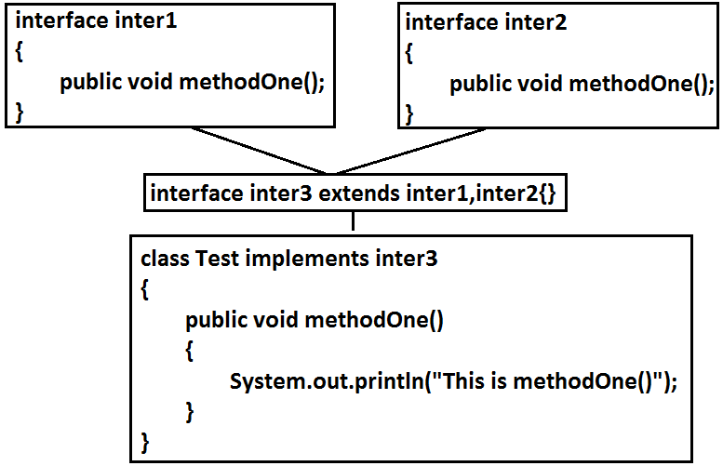

Slide 19
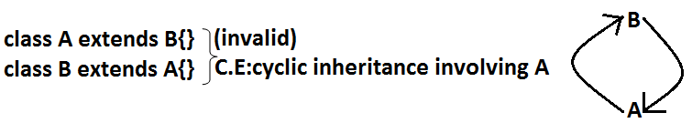
Cyclic Inheritance
Cyclic inheritance is not allowed in java.

Slide 20
HAS-A Relationship
HAS-A relationship is also known as composition (or) aggregation.
There is no specific keyword to implement HAS-A relationship but mostly we
can use new operator.
The main advantage of HAS-A relationship is reusability.
class Engine
{
//engine specific functionality
}
class Car {
Engine e=new Engine();
//........................;
//........................;
//........................;
}
class Car HAS-A engine reference.
The main dis-advantage of HAS-A relationship increases dependency between
the components and creates maintains problems.

Slide 21
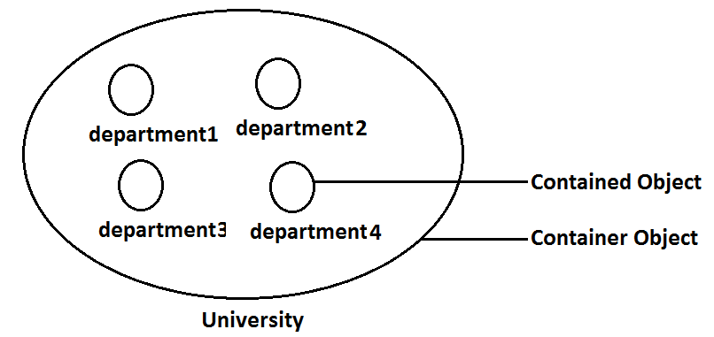
Composition vs Aggregation:
Composition:
Without existing container object if there is no chance of existing contained objects then the relationship between container object and contained object is called composition which is a strong association.
Example:
University consists of several departments whenever university object destroys automatically all the department objects will be destroyed that is without existing university object there is no chance of existing dependent object hence these are strongly associated and this relationship is called composition.

Slide 22
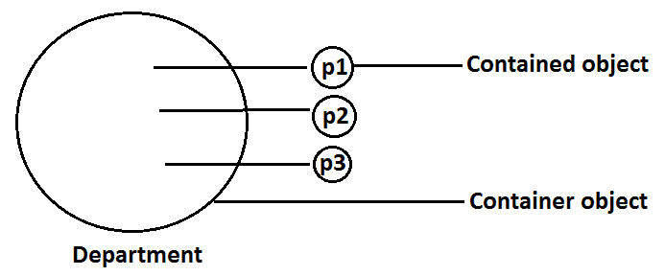
Aggregation
Aggregation :
Without existing container object if there is a chance of existing contained objects such type of relationship is called aggregation. In aggregation objects have weak association.
Example:
Within a department there may be a chance of several professors will work whenever we are closing department still there may be a chance of existing professor object without existing department object the relationship between department and professor is called aggregation where the objects having weak association.

Slide 23
Note :
In composition container , contained objects are strongly associated, and but container object holds contained objects directly But in Aggregation container and contained objects are weakly associated and container object just now holds the reference of contained objects.

Slide 24
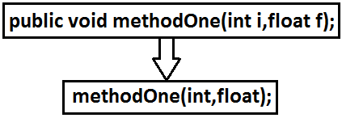
Method Signature
In java, method signature consists of name of the method followed by argument types.
In java return type is not part of the method signature.
• Compiler will use method signature while resolving method calls.
Within the same class we can't take 2 methods with the same signature otherwise we will get compile time error.

Slide 25
Polymorphism
Same name with different forms is the concept of polymorphism. Example 1: We can use same abs() method for int type, long type, float type etc.
Example:
1. abs(int)
2. abs(long)
3. abs(float)
Example 2: We can use the parent reference to hold any child objects. We can use the same List reference to hold ArrayList object, LinkedList object, Vector object, or Stack object.
Example:
List l=new ArrayList();
List l=new LinkedList();
List l=new Vector();
List l=new Stack();

Slide 26
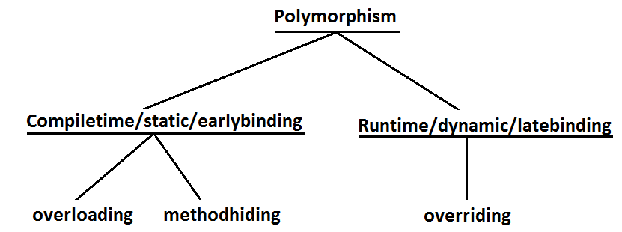

Slide 27
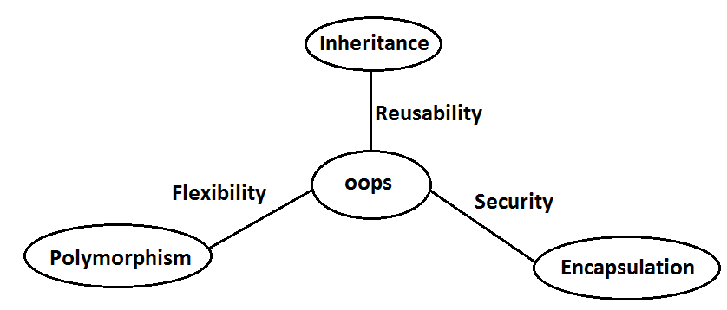
Most Important Features
1) Inheritance talks about reusability.
2) Polymorphism talks about flexibility.
3) Encapsulation talks about security.

Slide 28
Method Overloading
Two methods are said to be overload if and only if both having the same name but different argument types.
In java we can take multiple methods with the same name and different
argument types.

Slide 29
Abstract class is declared with the abstract keyword.
It may have both abstract and non-abstract methods(methods with bodies).
An abstract is a Java modifier applicable for classes and methods in Java but not for Variables.
abstract class Shape
{
int color;
// An abstract function
abstract void draw();
}

Slide 30
An instance of an abstract class can not be created.
Constructors are allowed.
We can have an abstract class without any abstract method.
There can be a final method in abstract class but any abstract method in class(abstract class) can not be declared as final or in simpler terms final method can not be abstract itself as it will yield an error: “Illegal combination of modifiers: abstract and final”
We can define static methods in an abstract class
We can use the abstract keyword for declaring top-level classes (Outer class) as well as inner classes as abstract
If a class contains at least one abstract method then compulsory should declare a class as abstract
If the Child class is unable to provide implementation to all abstract methods of the Parent class then we should declare that Child class as abstract so that the next level Child class should provide implementation to the remaining abstract method

Slide 31
1. Example of Abstract Class that has Abstract method
//Abstract class
abstract class Sunstar {
abstract void printInfo();
}
//Abstraction performed using extends
class Employee extends Sunstar {
void printInfo()
{
String name = "avinash";
int age = 21;
float salary = 222.2F;
System.out.println(name);
System.out.println(age);
System.out.println(salary);
}
}
//Base class
class Base {
public static void main(String args[])
{
Sunstar s = new Employee();
s.printInfo();
}
}

Slide 32
2. Abstract Class having constructor, data member, and methods
Elements abstract class can have
data member
abstract method
method body (non-abstract method)
constructor
main() method.

Slide 33
//Implement Abstract Class having constructor, data member, and methods
abstract class Subject {
Subject() {
System.out.println("Learning Subject");
}
abstract void syllabus();
void Learn(){
System.out.println("Preparing Right Now!");
}
}
class IT extends Subject {
void syllabus(){
System.out.println("C , Java , C++");
}
}
class Demo {
public static void main(String[] args) {
Subject x=new IT();
x.syllabus();
x.Learn();
}
}

Slide 34
Properties of Abstract class
1. we can have references to abstract class type but not object.
//Abstract class
abstract class Base {
abstract void fun();
}
class Derived extends Base {
void fun()
{
System.out.println("Derived fun() called");
}
}
class Main {
public static void main(String args[])
{
//Base b = new Base();
// but We can have references of Base type.
Base b = new Derived();
b.fun();
}
}

Slide 35
2. an abstract class can contain constructors in Java. And a constructor of an abstract class is called when an instance of an inherited class is created.

Slide 36
//Abstract class
abstract class Base {
// Constructor of abstract class
Base()
{
System.out.println("Base Constructor Called");
}
// Abstract method inside abstract class
abstract void fun();
}
class Derived extends Base {
// Constructor of Derived class
Derived()
{
System.out.println("Derived Constructor Called");
}
// implemented method of class2
void fun()
{
System.out.println("Derived fun() called");
}
}
class Demo {
public static void main(String args[])
{
// Creating object of Derived inside main() method
Derived d = new Derived();
d.fun();
}
}

Slide 37
3. We can have abstract class without any abstract method.
This allows us to create classes that cannot be instantiated but can only be inherited.

Slide 38
class Main {
public static void main(String args[])
{
Derived d = new Derived();
d.fun();
}
}
//An abstract class without
any abstract method
abstract class Base {
//This is not an abstract method.
void fun()
{
System.out.println("Base class fun() is called");
}
}
class Derived extends Base {
// This class only inherits the Base class methods and
// properties
}

Slide 39
Abstract classes can also have final methods (methods that cannot be overridden)

Slide 40
abstract class Base {
final void fun()
{
System.out.println("Base fun() called");
}
}
class Derived extends Base {
}
class Demo {
public static void main(String args[])
{
Base b = new Derived();
b.fun();
}
}

Slide 41
an abstract class instantiation is not possible.
abstract class AbstractClass {
public static void main(String args[])
{
// Trying to create an object
AbstractClass gfg = new AbstractClass();
}
}

Slide 42
we can define static methods in an abstract class that can be called independently without an object.
abstract class Helper {
static void demofun()
{
System.out.println("Geeks for Geeks");
}
}
public class Derived extends Helper {
public static void main(String[] args)
{
Helper.demofun();
}
}

Slide 43
We can use the abstract keyword for declaring top-level classes (Outer class) as well as inner classes as abstract
abstract class B {
// inner class as abstract
abstract class C {
abstract void myAbstractMethod();
}
}
class D extends B {
class E extends C {
// implementing the abstract method
void myAbstractMethod()
{
System.out.println(
"Inside abstract method implementation");
}
}
}

Slide 44
public class Main {
public static void main(String args[])
{
// Instantiating the outer class
D outer = new D();
// Instantiating the inner class
D.E inner = outer.new E();
inner.myAbstractMethod();
}
}

Slide 45
If a class contains at least one abstract method then compulsory we should declare the class as abstract otherwise we will get a compile-time error.
we should use abstract keyword.

Slide 46
abstract class Base {
abstract void m1();
}
class Child extends Base {
public void m1()
{
System.out.print("Hello");
}
}
class Demo {
public static void main(String[] args)
{
Child c = new Child();
c.m1();
}
}

Slide 47
If the Child class does not provide implementation to all abstract methods of the Parent class then we should declare that Child class as abstract so that the next level Child class should provide implementation to the remaining abstract method.
abstract class Base {
abstract void m1();
abstract void m2();
abstract void m3();
}

Slide 48
abstract class FirstChild extends Base {
public void m1() {
System.out.println("Inside m1");
}
}
class SecondChild extends FirstChild {
public void m2() {
System.out.println("Inside m2");
}
public void m3() {
System.out.println("Inside m3");
}
}
class Demo {
public static void main(String[] args)
{
// FirstChild f=new FirstChild();
// f.m1();
SecondChild s = new SecondChild();
s.m1();
s.m2();
s.m3();
}
}

Slide 49
Interface
An Interface is an abstract type used to specify the behavior of a class.
An interface in Java is a blueprint of a behavior.
A Java interface contains static constants and abstract methods.
a mechanism to achieve abstraction and multiple Inheritance.
Traditionally, an interface could only have abstract methods (methods without a body) and public, static, and final variables by default.

Slide 50
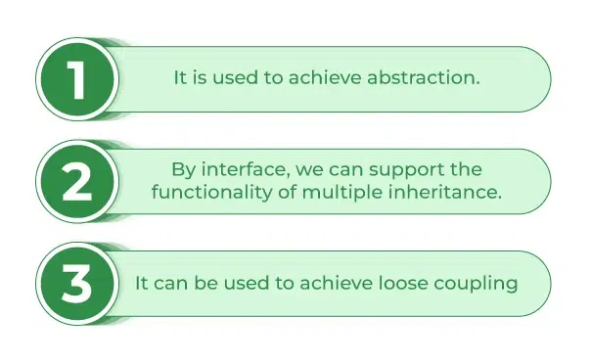

Slide 51
When we decide on a type of entity by its behavior and not via attribute we should define it as an interface.
interface { // declare constant fields // declare methods that abstract // by default. }

Slide 52
Uses of Interfaces in Java are mentioned below:
It is used to achieve total abstraction.
Since java does not support multiple inheritances in the case of class, by using an interface it can achieve multiple inheritance.
Any class can extend only one class, but can implement multiple interfaces.
It is also used to achieve loose coupling.
Interfaces are used to implement abstraction.
abstract classes may contain non-final variables, whereas variables in the interface are final, public, and static.
// A simple interface interface Player { final int id = 10; int move(); }

Slide 53
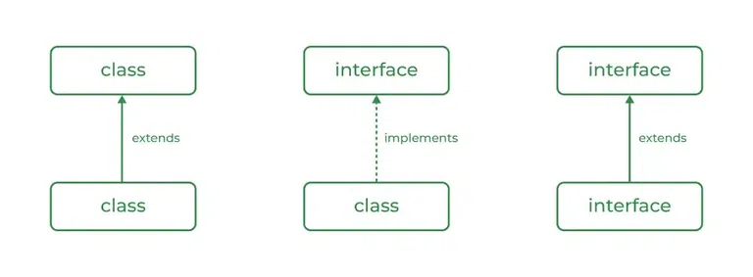
Class vs Interface

Slide 54
Class | Interface
In class, you can instantiate variables and create an object. | In an interface, you must initialize variables as they are final but you can’t create an object.
A class can contain concrete (with implementation) methods | The interface cannot contain concrete (with implementation) methods.
The access specifiers used with classes are private, protected, and public. | In Interface only one specifier is used- Public.

Slide 55
Abstract Class vs Interface
Points | Abstract Class | Interface
Definition | Cannot be instantiated; contains both abstract (without implementation) and concrete methods (with implementation) | Specifies a set of methods a class must implement; methods are abstract by default.
Implementation Method | Can have both implemented and abstract methods. | Methods are abstract by default; Java 8, can have default and static methods.
Inheritance | class can inherit from only one abstract class. | A class can implement multiple interfaces.
Access Modifiers | Methods and properties can have any access modifier (public, protected, private). | Methods and properties are implicitly public.
Variables | Can have member variables (final, non-final, static, non-static). | Variables are implicitly public, static, and final (constants).

Slide 56
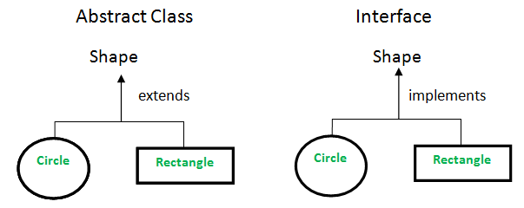

Slide 57
Abstract Class
An abstract class is a class that cannot be instantiated directly. It serves as a blueprint for other classes to derive from.
An abstract class can contain both abstract methods (methods without an implementation) and concrete methods (methods with an implementation).
Abstract classes can have member variables, including final, non-final, static, and non-static variables.
Abstract classes can have constructors, which can be used to initialize variables in the abstract class when it is instantiated by a subclass.

Slide 58
//A simple interface
interface In1 {
// public, static and final
final int a = 10;
// public and abstract
void display();
}
//A class that implements the interface.
class TestClass implements In1 {
// Implementing the capabilities of
// interface.
public void display(){
System.out.println("Geek");
}
// Driver Code
public static void main(String[] args)
{
TestClass t = new TestClass();
t.display();
System.out.println(t.a);
}
}

Slide 59
interface Vehicle {
void changeGear(int a);
void speedUp(int a);
void applyBrakes(int a);
}
class Bicycle implements Vehicle{
int speed;
int gear;
// to change gear
@Override
public void changeGear(int newGear){
gear = newGear;
}
// to increase speed
@Override
public void speedUp(int increment){
speed = speed + increment;
}
// to decrease speed
@Override
public void applyBrakes(int decrement){
speed = speed - decrement;
}
public void printStates() {
System.out.println("speed: " + speed
+ " gear: " + gear);
}
}

Slide 60
class Bike implements Vehicle {
int speed;
int gear;
// to change gear
@Override
public void changeGear(int newGear){
gear = newGear;
}
// to increase speed
@Override
public void speedUp(int increment){
speed = speed + increment;
}
// to decrease speed
@Override
public void applyBrakes(int decrement){
speed = speed - decrement;
}
public void printStates() {
System.out.println("speed: " + speed
+ " gear: " + gear);
}
}

Slide 61
class Demo {
public static void main (String[] args) {
// creating an instance of Bicycle
// doing some operations
Bicycle bicycle = new Bicycle();
bicycle.changeGear(2);
bicycle.speedUp(3);
bicycle.applyBrakes(1);
System.out.println("Bicycle present state :");
bicycle.printStates();
// creating instance of the bike.
Bike bike = new Bike();
bike.changeGear(1);
bike.speedUp(4);
bike.applyBrakes(3);
System.out.println("Bike present state :");
bike.printStates();
}
}

Slide 62
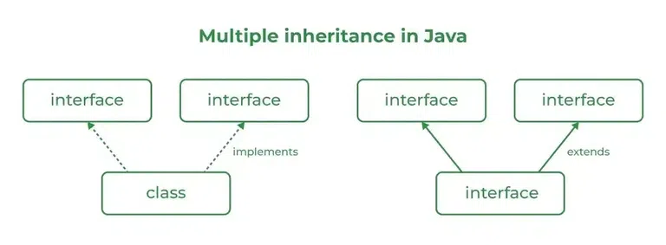

Slide 63
//Interface 1
interface API {
default void show()
{
System.out.println("Default API");
}
}
//Interface 2
//Extending the above interface
interface Interface1 extends API {
// Abstract method
void display();
}
//Interface 3
//Extending the above interface
interface Interface2 extends API {
// Abstract method
void print();
}

Slide 64
class TestClass implements Interface1, Interface2 {
// Overriding the abstract method from Interface1
public void display()
{
System.out.println("Display from Interface1");
}
// Overriding the abstract method from Interface2
public void print()
{
System.out.println("Print from Interface2");
}
public static void main(String args[])
{
TestClass d = new TestClass();
d.show(); // Default method from API
d.display(); // Overridden method from Interface1
d.print(); // Overridden method from Interface2
}
}

Slide 65
interface A {
void method1();
void method2();
}
// B now includes method1 and method2
interface B extends A {
void method3();
}
// the class must implement all method of A and B.
class ClassA implements B {
public void method1()
{
System.out.println("Method 1");
}
public void method2()
{
System.out.println("Method 2");
}
public void method3()
{
System.out.println("Method 3");
}
}

Slide 66
//Level 1
interface Bank {
void deposit();
void withdraw();
void loan();
void account();
}
//Level 2
abstract class Dev1 implements Bank {
public void deposit()
{
System.out.println("Your deposit Amount :" + 100);
}
}
abstract class Dev2 extends Dev1 {
public void withdraw()
{
System.out.println("Your withdraw Amount :" + 50);
}
}

Slide 67
//Level 3
class Dev3 extends Dev2 {
public void loan() {}
public void account() {}
}
//Level 4
class Demo {
public static void main(String[] args)
{
Dev3 d = new Dev3();
d.account();
d.loan();
d.deposit();
d.withdraw();
}
}

Slide 68
Super keyword
Characteristics of Super Keyword in Java
Use of super keyword in Java
1. Use of super with Variables
2. Use of super with Methods
3. Use of super with constructors
Advantages of Using Java Super Keyword

Slide 69
Characteristics of super
super is used to call a superclass constructor:
When a subclass is created, its constructor must call the constructor of its parent class. This is done using the super() keyword, which calls the constructor of the parent class.
super is used to call a superclass method:
A subclass can call a method defined in its parent class using the super keyword. This is useful when the subclass wants to invoke the parent class’s implementation of the method in addition to its own.
super is used to access a superclass field:
A subclass can access a field defined in its parent class using the super keyword. This is useful when the subclass wants to reference the parent class’s version of a field.
super must be the first statement in a constructor:
When calling a superclass constructor, the super() statement must be the first statement in the constructor of the subclass.

Slide 70
super cannot be used in a static context:
The super keyword cannot be used in a static context, such as in a static method or a static variable initializer.
super is not required to call a superclass method:
While it is possible to use the super keyword to call a method in the parent class, it is not required. If a method is not overridden in the subclass, then calling it without the super keyword will invoke the parent class’s implementation.

Slide 71
Use of super keyword in Java
It is majorly used in the following contexts as mentioned below:
Use of super with Variables
Use of super with Methods
Use of super with Constructors

Slide 72
//Base class vehicle
class Vehicle {
int maxSpeed = 120;
}
//sub class Car extending vehicle
class Car extends Vehicle {
int maxSpeed = 180;
void display()
{
// print maxSpeed of base class (vehicle)
System.out.println("Maximum Speed: "
+ super.maxSpeed);
}
}
//Driver Program
class Test {
public static void main(String[] args)
{
Car small = new Car();
small.display();
}
}

Slide 73
class Person {
void message()
{
System.out.println("This is person class\n");
}
}
class Student extends Person {
void message()
{
System.out.println("This is student class");
}
// Note that display() is only in Student class
void display()
{
message(); //call current class message() method
super.message(); //call parent class message() method
}
}
//Driver Program
class Test {
public static void main(String args[])
{
Student s = new Student();
s.display(); // calling display() of Student
}
}

Slide 74
class Person {
Person()
{
System.out.println("Person class Constructor");
}
}
//subclass Student extending the Person class
class Student extends Person {
Student()
{
// invoke or call parent class constructor
super();
System.out.println("Student class Constructor");
}
}
//Driver Program
class Test {
public static void main(String[] args)
{
Student s = new Student();
}
}

Slide 75
Advantages of Super Keyword
Enables reuse of code:
Using the super keyword allows subclasses to inherit functionality from their parent classes, which promotes the reuse of code and reduces duplication.
Supports polymorphism:
Because subclasses can override methods and access fields from their parent classes using super, polymorphism is possible. This allows for more flexible and extensible code.
Provides access to parent class behaviour:
Subclasses can access and use methods and fields defined in their parent classes through the super keyword, which allows them to take advantage of existing behaviour without having to reimplement it.
Allows for customization of behaviour:
By overriding methods and using super to call the parent implementation, subclasses can customize and extend the behaviour of their parent classes.
Facilitates abstraction and encapsulation:
The use of super promotes encapsulation and abstraction by allowing subclasses to focus on their behaviour while relying on the parent class to handle lower-level details.

Slide 76
Anonymous Class

Slide 77
THANK
YOU

